Slide 1
Research on open-source data on citi-bike New York
26/12/2021

Slide 2

Intro
Citi Bike is a privately owned public bicycle sharing system serving New York City. First proposed in 2008 by the New York City Department of Transportation, Citi Bike's scheduled 2011 opening was delayed by Hurricane Sandy and technological problems. It officially opened in May 2013 with 332 stations and 6,000 bikes. By October 2017 the totals were 706 stations and 12,000 bikes, making the service the largest bike sharing program in the United States. In October 2017 the system reached a total of 50 million rides and in July 2020 the system reached 100 million rides. As of July 2019, there are 169,000 annual subscribers. Monthly average ridership numbers increased above 100,000 for the first time in June 2021. The all-time record for single-day ridership occurred on September 12, 2021, when the system had 135,005 rides.

Slide 3
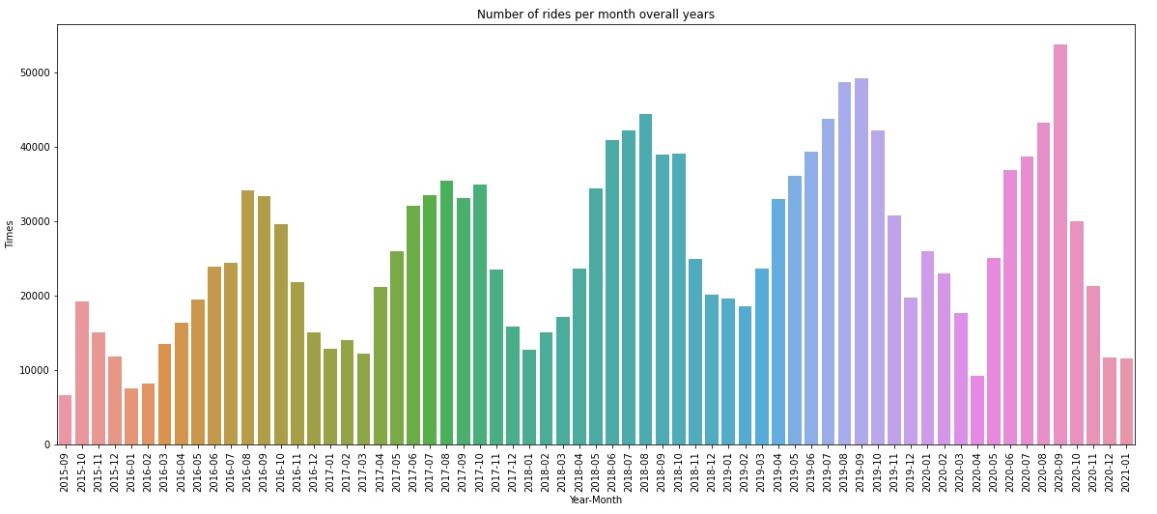
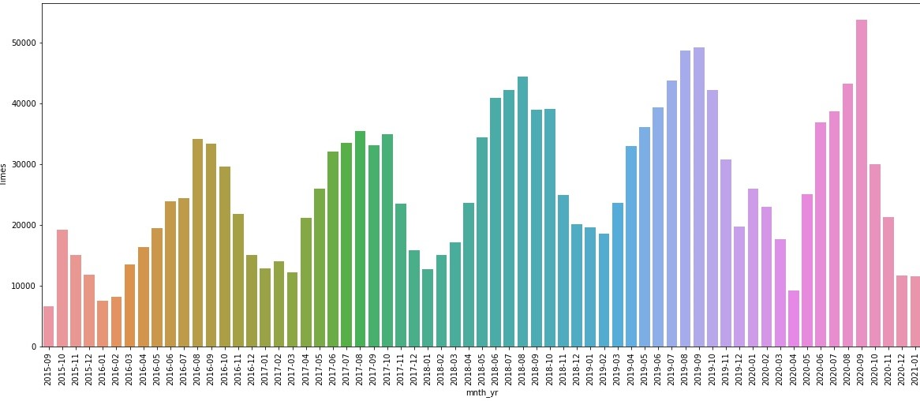
Total rides over all months and years
The general tendency is positive as it can be seen from the graph. There are also cyclical falls and rises corresponding to cold and warm weather respectfully. Furthermore there is a sudden fall starting from December 2019 and it lasted several months which correspond to the period of time when the Corona virus started to spread.

Slide 4
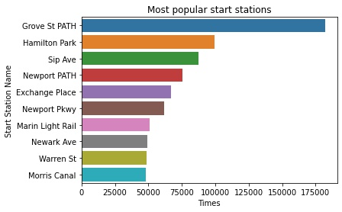
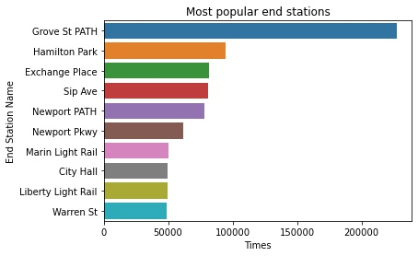
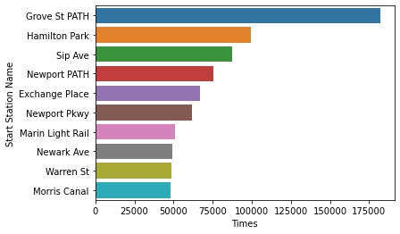
Top 10 Start and End Stations according to the number of rides
The left graph shows top 10 Start Stations per number of rides over all time. The top one station which is Grove St Path has had almost twice as much rides as the next station on the list.
The right graph shows top 10 End Stations per number of rides over all time. The top one station corresponds to the top one start station which is Grove St Path has had more than twice as much rides as the next station on the list. Furthermore as it is seen people tend to return more bikes at this station than they rent.

Slide 5

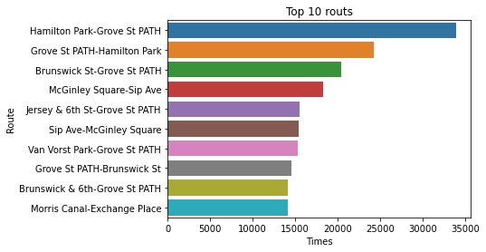
Top 10 routs over all time
As it is seen from the chart almost every rout includes Grove St Path as it is most popular station. Two top charts represent 2 routs between the same stations but opposite directions.

Slide 6

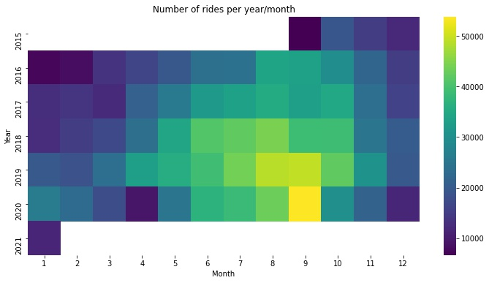
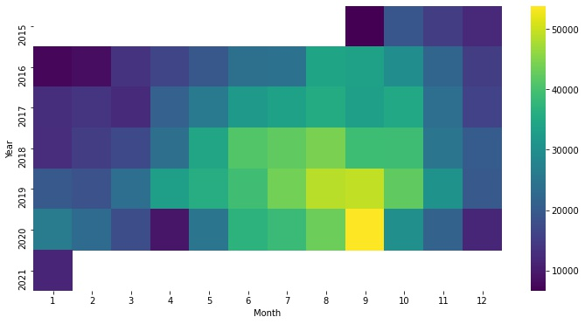
Heat map representing number of rides per month and year
As it can be seen according to the given heatmap most popular months to rent a bike are warm months (from June until October partly) with the highest value in September 2020. Months with highest number of rides are August and September almost every year.

Slide 7

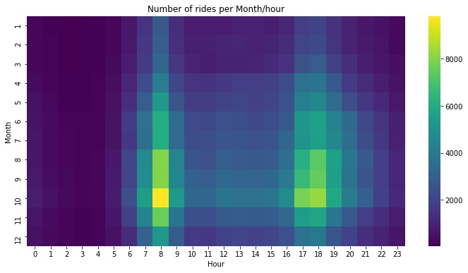
Heat map representing number of rides per month and hour
The given heatmap gives us an understanding of most busy hours. As it easily can be seen most busy hours are 7-9 am and 5-6 pm every month but it rises in warm months: from July to October. The number of rides during night hours is quite small.

Slide 8
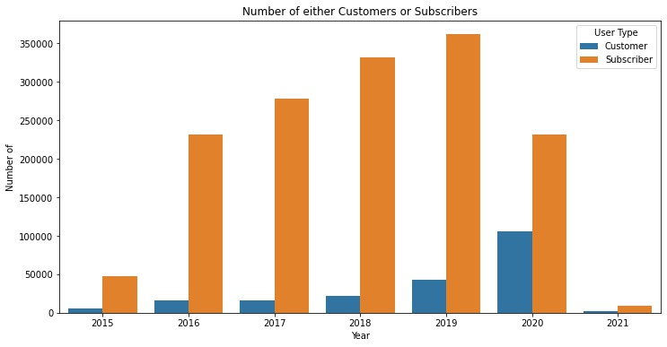
User types
As it is seen from the bar graph the number of users is constantly growing. Year 2015 has only 3 months in it and year 2021 has only January data. Year 2020 has such a fall due to Corona virus difficulties and restrictions.

Slide 9

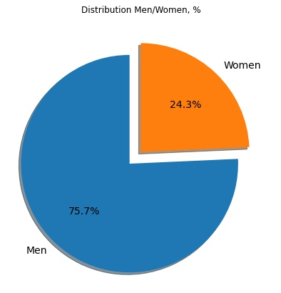
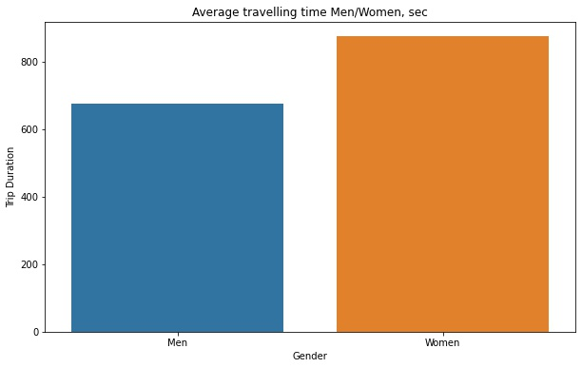
Men/women information
Despite the fact that women represent less than 25% of the total number of rides, the average travelling time is higher in comparison to men by slightly more than 20%

Slide 10
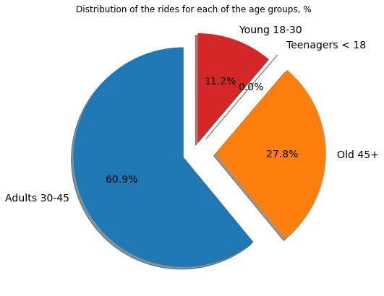
Age information
Surprisingly the most renting bikes group is Adults at the age of 30-45. The second group is taken by old people 45+. Young people at the age from 18 to 30 are the least renting bikes group which is completely surprising and only several times teenagers rented bicycles.

Slide 11
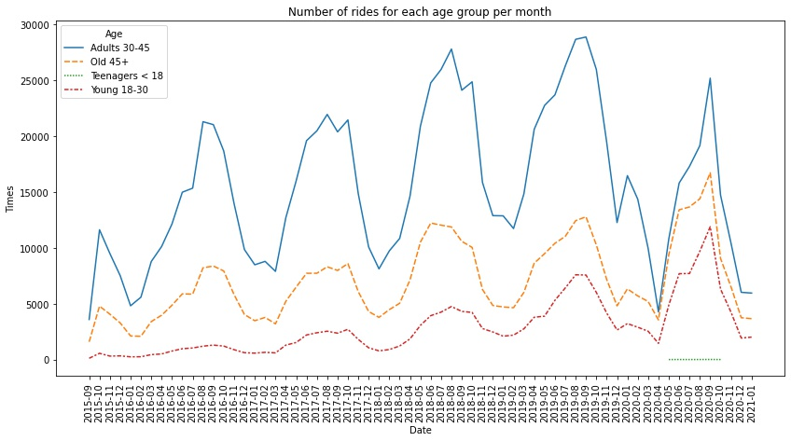
Age information 2
The given line graph shows us how many times various age groups rented bikes. AS it implicitly seen the Age group of Adults has always been the most renting group. The second renting group is Old 45+. There is a drastic fall at the beginning of 2020 most likely caused by Corona virus. We can also see the green line meaning the least renting group which is Teenagers rented bikes several times in 2020 only.

Slide 12
General Conclusions
Men represent a little over 75% of all rides.
Despite the fact men ride more often the average time travelling of women is nearly 20% more.
8 out of top 10 Start and End stations correspond to each other.
There was constant growth in the number of rides since 2015 until the pandemic started to spread around.
2 Top months with highest number of rides are August and September.
2 busiest periods of time per day are 7-9 am and 5-6 pm most likely when people go to and from work.
The most renting age group is 30-45 and it represents 60.9% of total rides, the second group is Adults which represent 27.8%. The rest is represented by the Young with 11.2%.
The number of rides of random customers is significantly less than subscribers’.
7 out of 10 top routs include top 1 station.

Slide 13

Thank you for you attention!

